Slide 1


Equal North Research and Practice Network
Professor Eileen Kaner
Professor Clare Bambra
Dr Michelle Addison
Funded by SPHR NIHR

Slide 2
Health Inequalities / inequity
Inequality
‘differences in health status or in the distribution of health determinants between different population groups’ e.g. mobility amongst older people
Inequity
When these differences are deemed to be unfair / unjust, and avoidable e.g. north / south divide (Bambra, 2016). It is a normative concept, can be traced to unequal social and economic conditions. Some groups more vulnerable to poor health than others.
(WHO Glossary, 2018)
Notes:
Often used inter-changeably, because health inequalities are viewed to be unfair and unjust unless explicit.
These differences have a huge impact, because they result in people who are worst off experiencing poorer health and shorter lives.

Slide 3
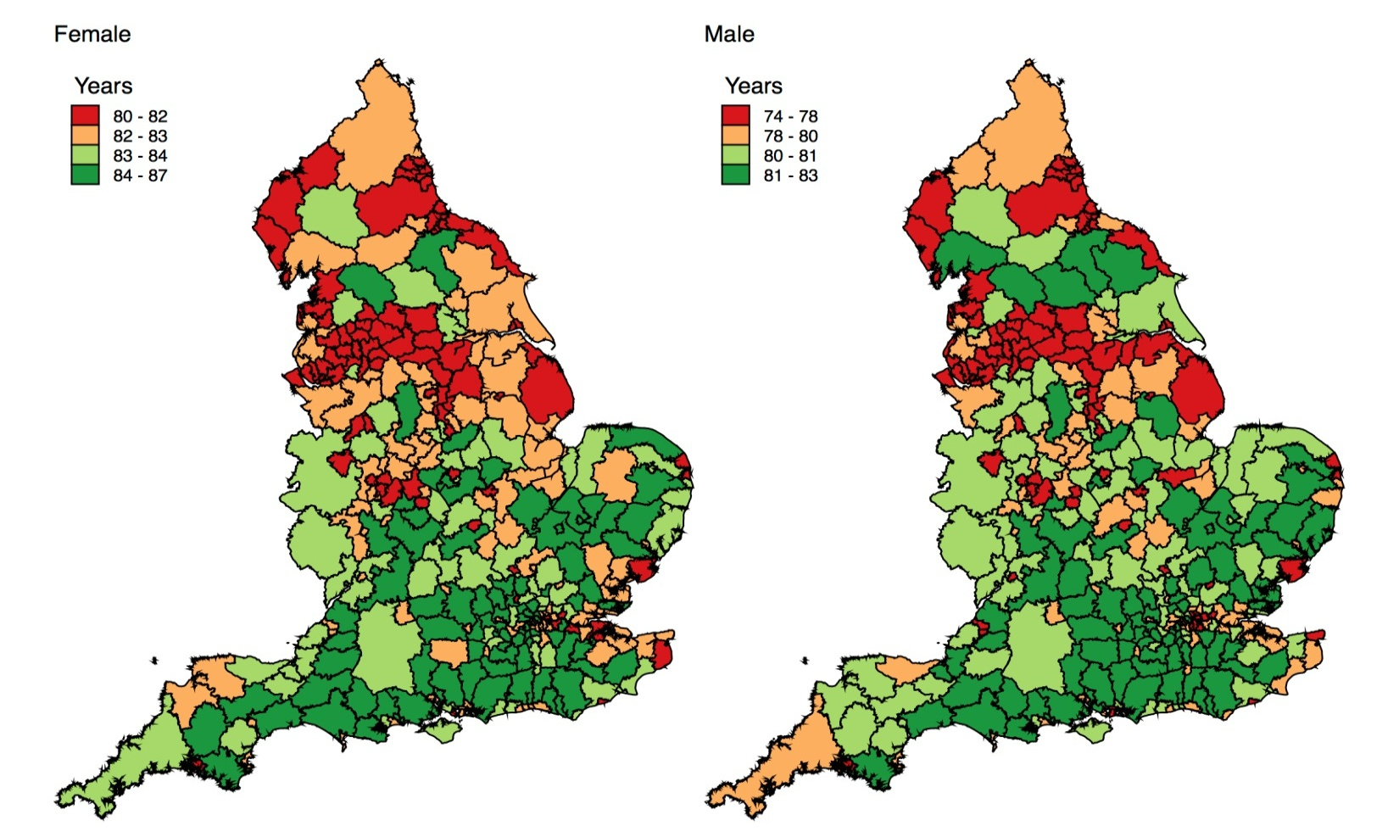
Life Expectancy: the North-South health Divide
Source: HSCIC, 2014
Notes:
There is a social gradient in health whereby those who reside in the 10% most deprived areas in England have a shorter life expectancy (gap of 7 years for women, 9 years for men) than those who live in the 10% least deprived areas (England, July 2017).
There is also a significant north / south health divide with life expectancy 2 years lower in the north (Bambra, 2016).
These health inequalities are considered unfair and unjust (Marmot, 2017, 2010; JRF, 2016; WHO 2008; Chang et al. 2016; Bambra, 2016) because they reflect ‘historic and present day social inequalities in our population’ (PHE, 2017). I

Slide 4
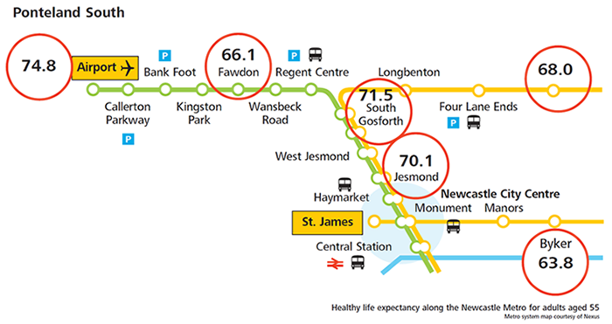
Inequalities in DFLE on the Newcastle Metro

Slide 5
Causes
Differences in poverty, power and resources needed for health
Differences in exposure to health-damaging factors
Differences in opportunities to enjoy positive health and protective conditions that help maintain health, especially conditions that give children the best possible start in life

Slide 6
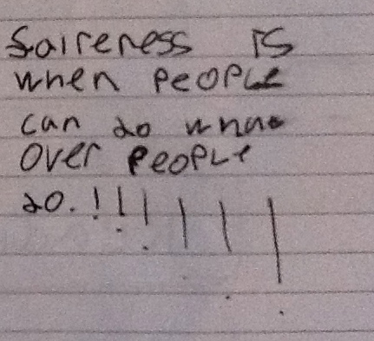
Sir Michael Marmot
Fair Society, Healthy Lives 2010
“Action to reduce health inequalities must start before birth and be followed through the life of the child. Only then can the close links between early disadvantage and poor outcomes throughout life be broken. For this reason, giving every child the best start in life is our highest priority recommendation.”

Slide 7
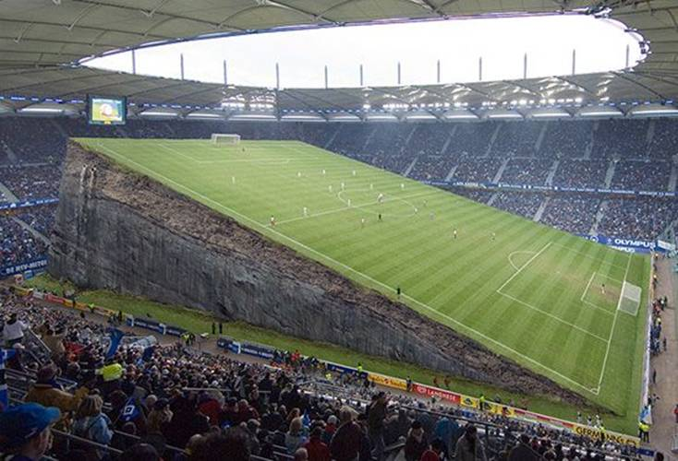

We need to level the playing field for all our children and young people
http://fuse.ac.uk/research/healthinequalities/equalnorthresearchandpracticenetwork/

Slide 8
Equal North Network
A Northern Research Network of academics, policy and practice members
Mapping the skills and interests of members related to health and social inequalities, research and practice
4 network meetings across the North – in NE, NW, Y&H and London
Research Exercise identifying the priorities for future research (publication under review)
N=520+ members across NE, NW, and Y&H

Slide 9
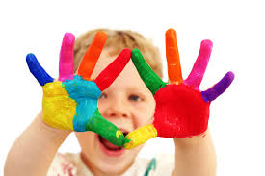
Workshop 4
Priority Research Areas to reduce Health Inequalities amongst children and young people
Key Questions to Discuss in groups
What do you think are the key health inequalities amongst CYP?
What can we do to help reduce child health inequities within the north and between north and south?
What does government need to do to reduce these inequalities?
How can research help with reducing health inequalities amongst CYP?

Slide 10
Join Equal North Network
Email Dr Michelle Addison, Lead Researcher: Michelle.Addison@ncl.ac.uk
Visit webpage: http://www.fuse.ac.uk/research/healthinequalities/equalnorthresearchandpracticenetwork/

Slide 11
Strategies for tackling childhood social and health inequalities in Middlesbrough
Quality & Safety Symposium
Improving the Experience of Children & Young People
Friday 9 March 2018
St James Park, Newcastle United Football Stadium, Newcastle upon Tyne

Slide 12

Outline
Scale of the challenge
Key areas of focus
Future challenges
Questions and discussion

Slide 13
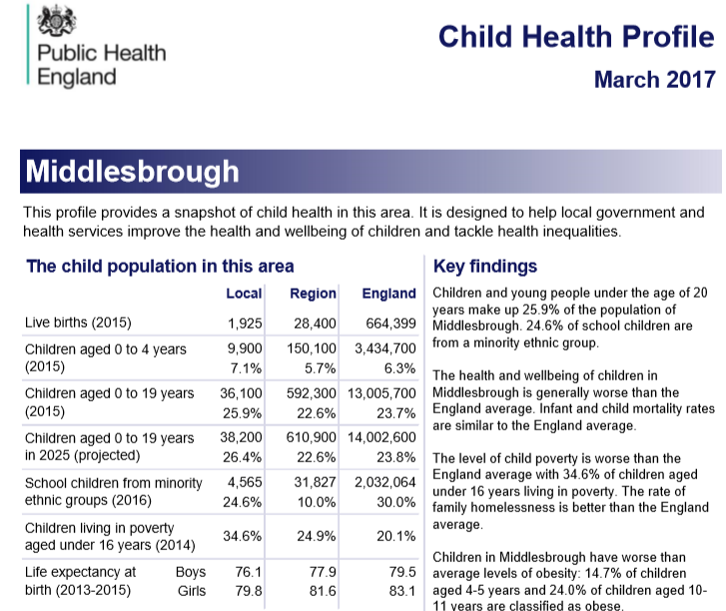

Slide 14
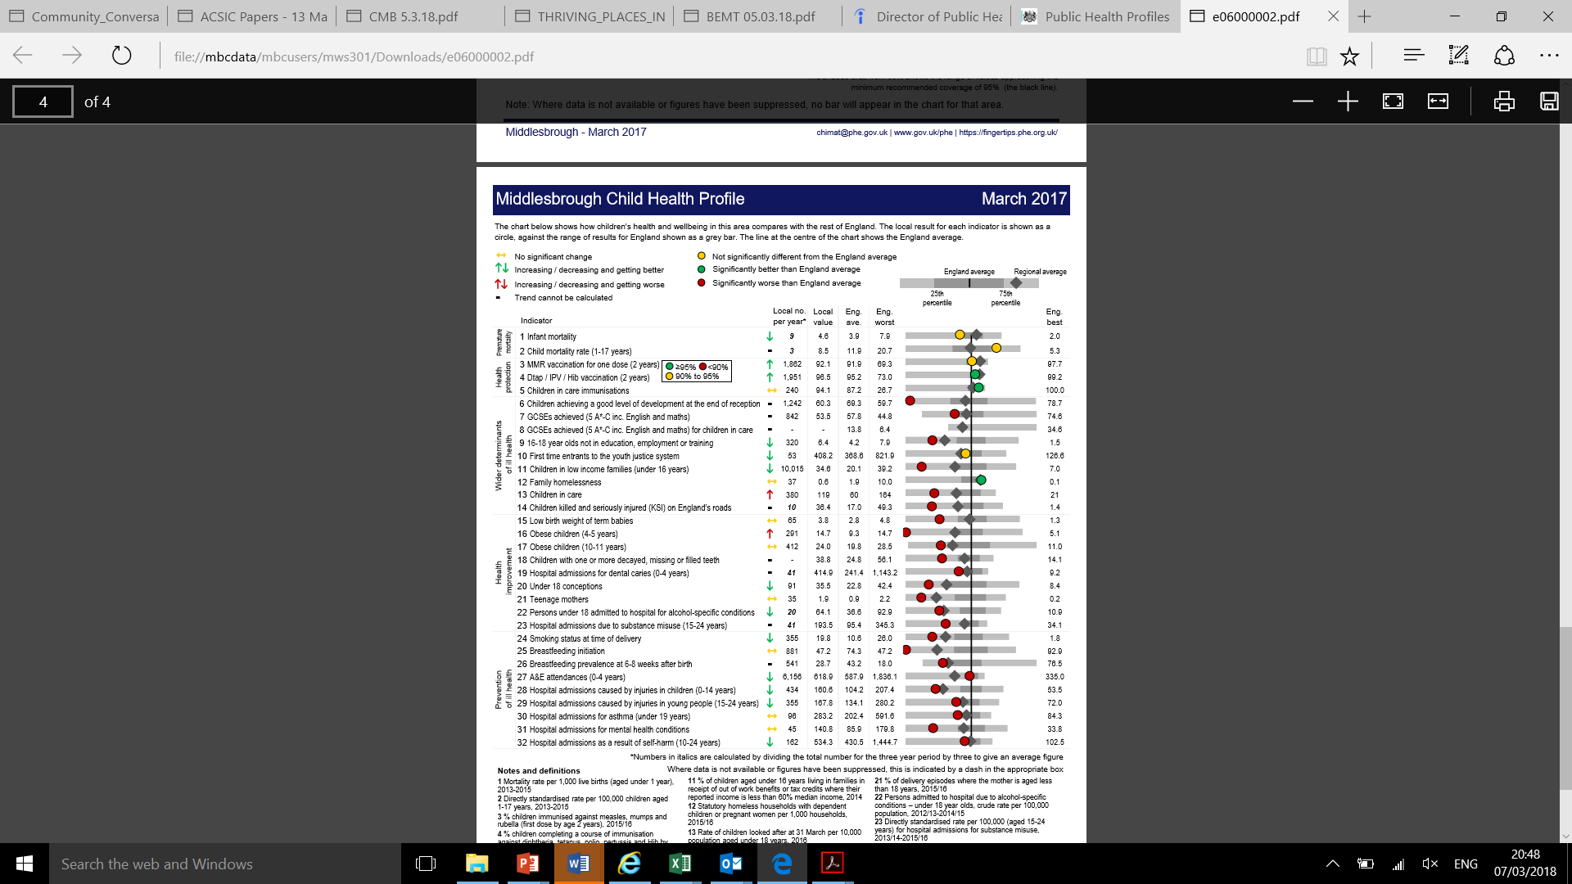

Slide 15


Slide 16
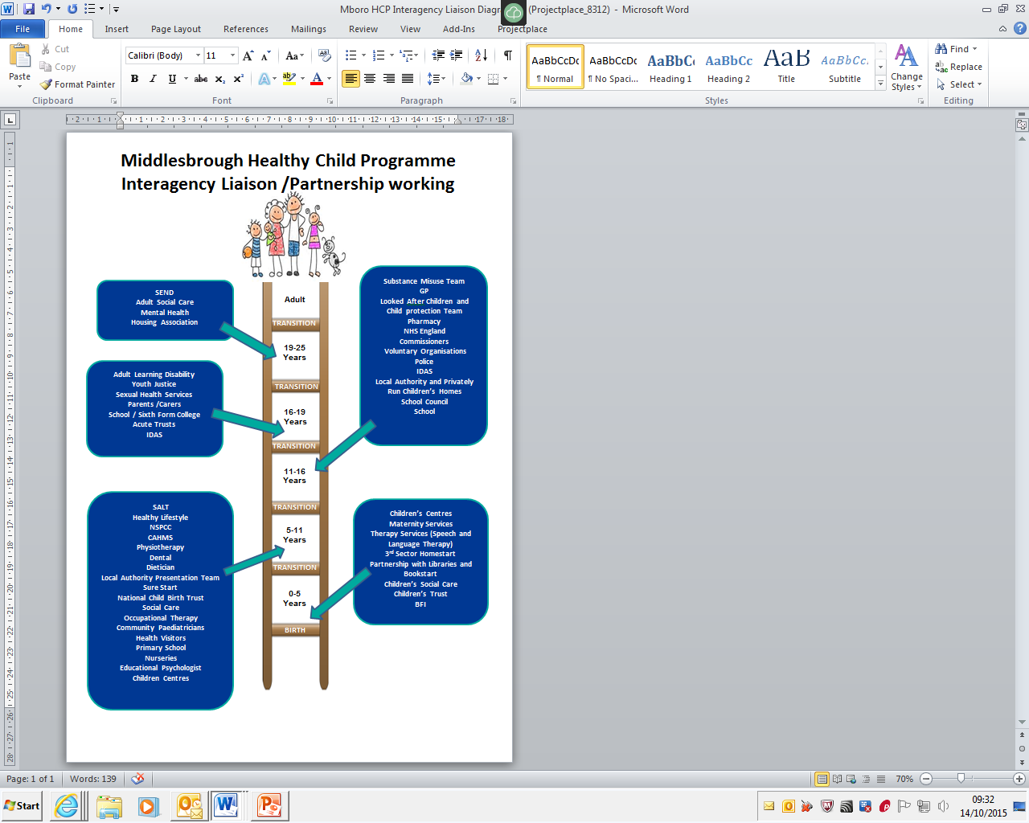
HCP

Slide 17
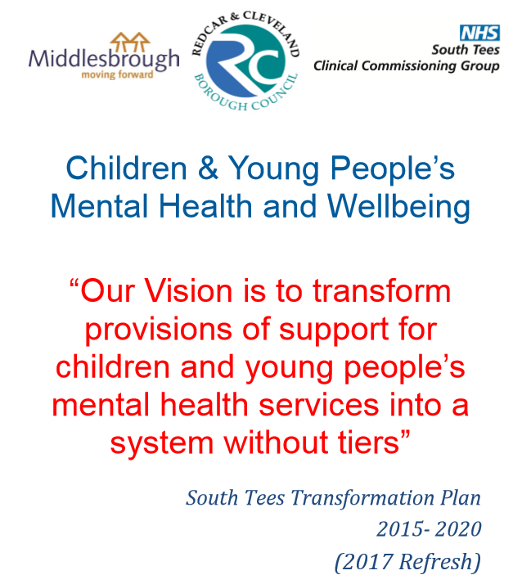
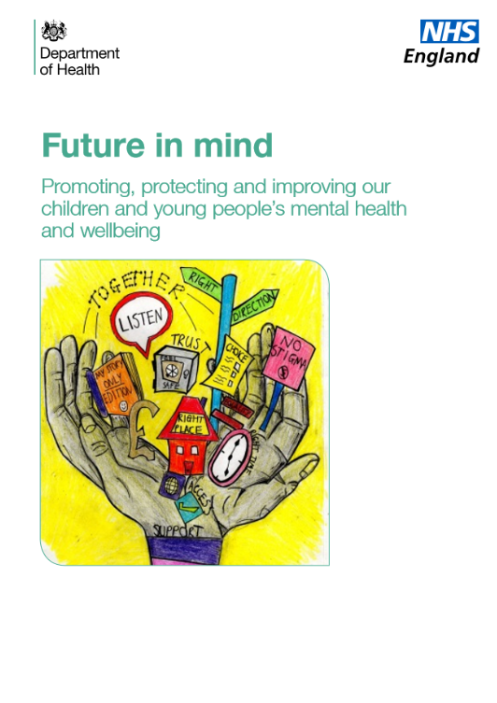
Improving mental health and emotional well-being

Slide 18
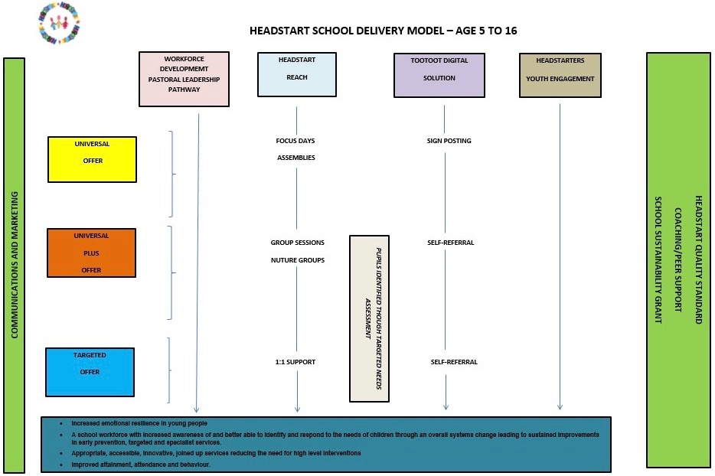
HEADSTART - ‘GIVING ALL MIDDLESBROUGH’S CHILDREN AND YOUNG PEOPLE THE NECESSARY SUPPORT TO BUILD RESILIENCE TO ACHIEVE GOOD EMOTIONAL HEALTH’

Slide 19


  Increased emotional resilience in young people
  A school workforce with increased awareness of and better able to identify and respond to the emotional needs of pupils
  systems change leading to sustained improvements in early prevention, targeted and specialist services.
  Appropriate, accessible, innovative, joined up services reducing the need for high level interventions
  Improved attainment, attendance and behaviour.

Slide 20


Reading Town

Slide 21
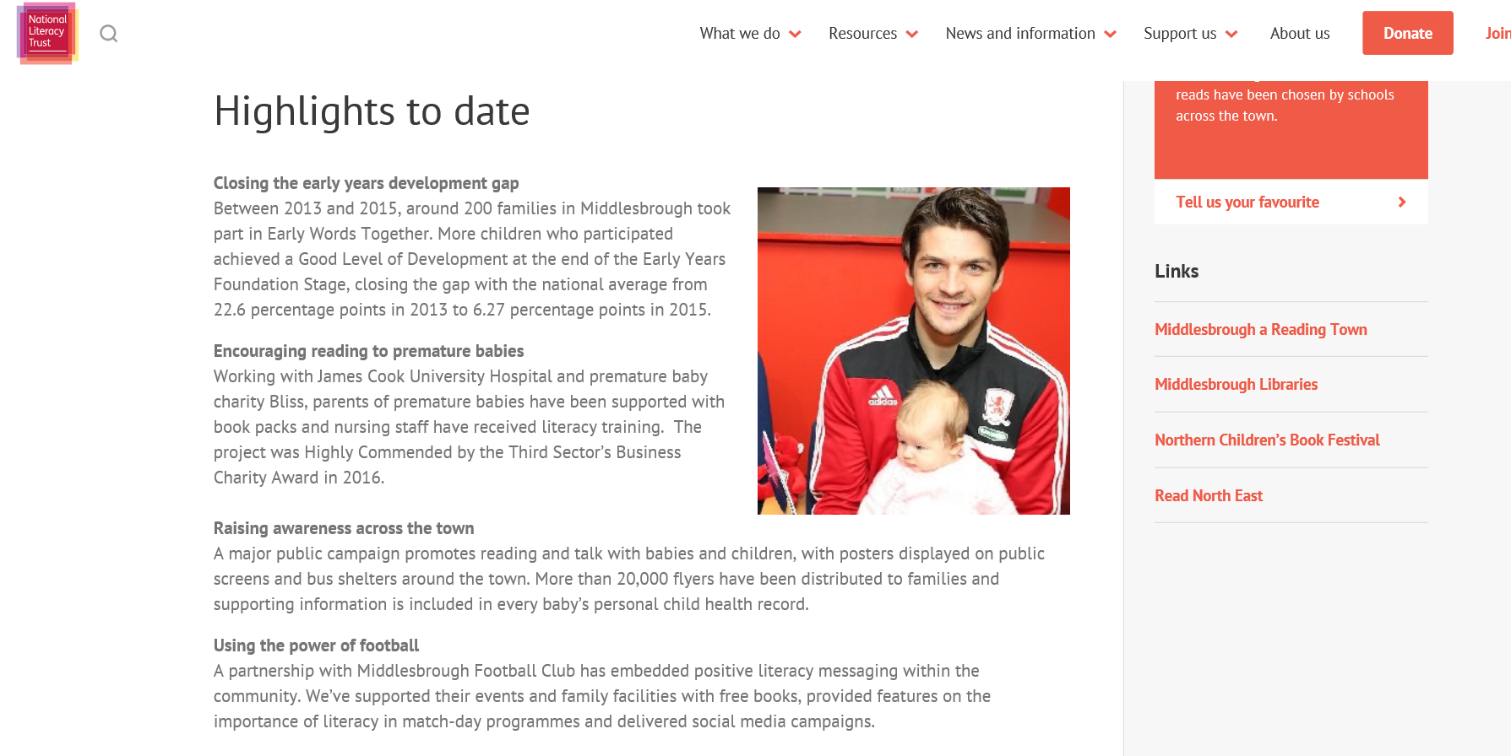

Slide 22


Slide 23
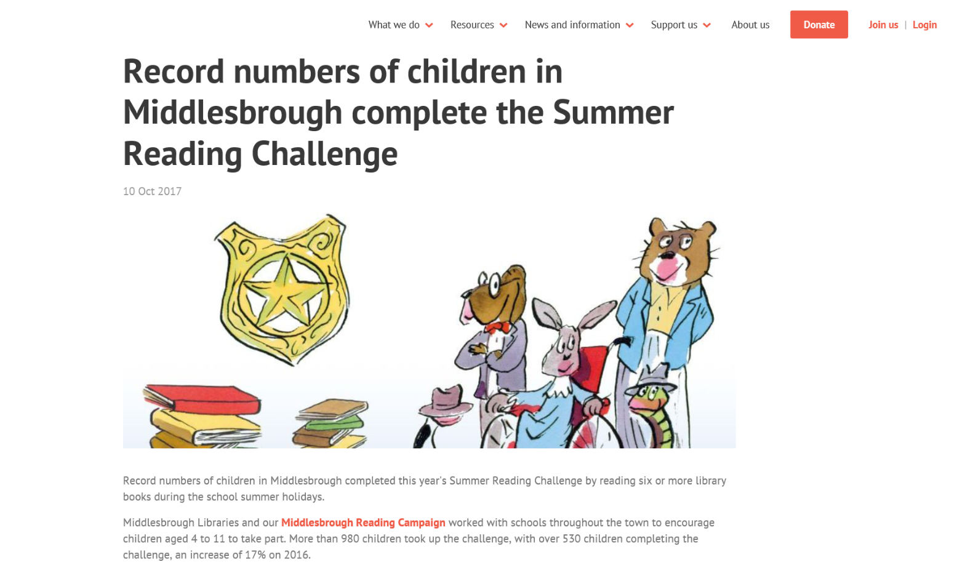

Slide 24
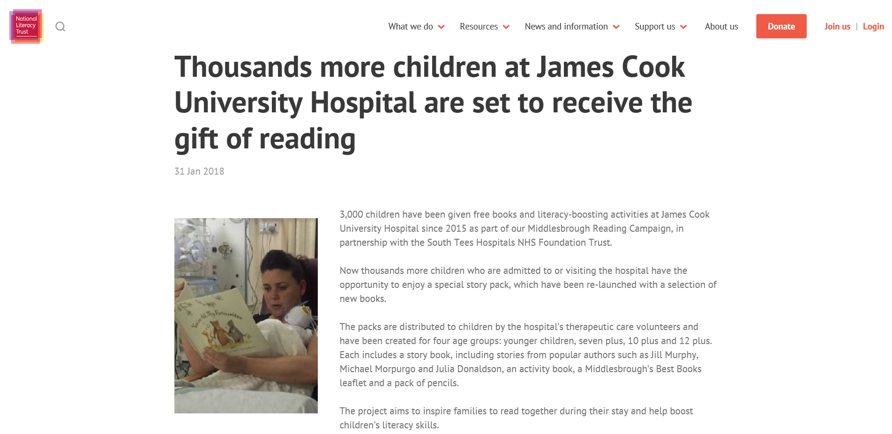

Slide 25
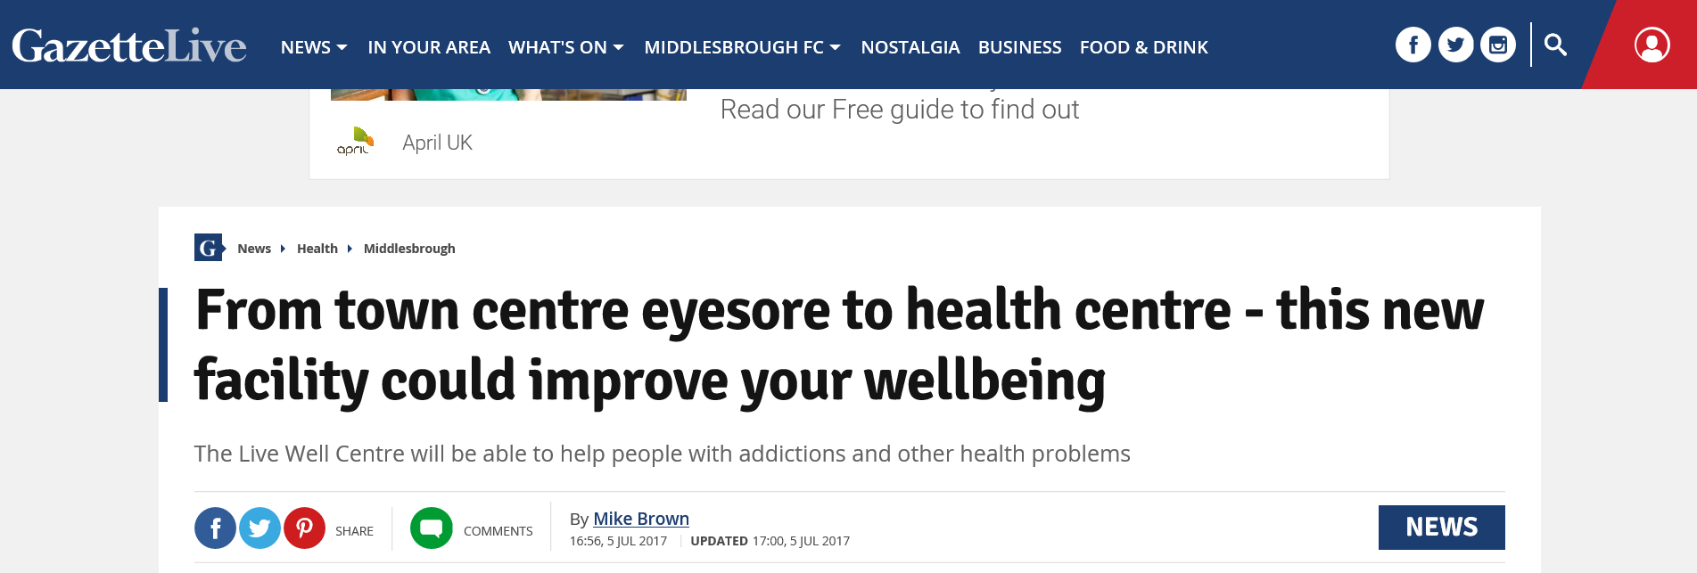
Live Well Centre

Slide 26
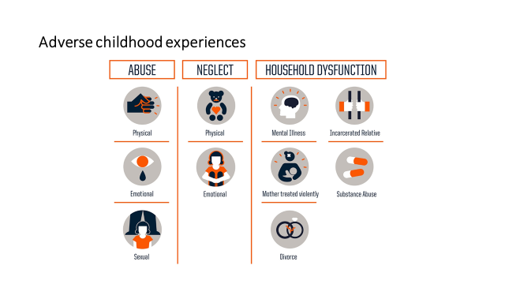
Social determinants of health
Selective landlord licensing scheme
Tackling fuel poverty
School improvement programme
Holiday hunger scheme
Investment strategy
Social regeneration
TV Combined Authority
South Tees Mayoral development Corporation

Slide 27
Future challenges
Austerity and cuts
‘Shrinking together or shrinking apart’
Increasing demand in children’s social care – Barnet graph of Doom and Birmingham's Jaws of doom!
Investment in prevention vs burning platform
Multi-cultural town – new emerging communities
Adverse Childhood Experiences (ACEs)

Slide 28
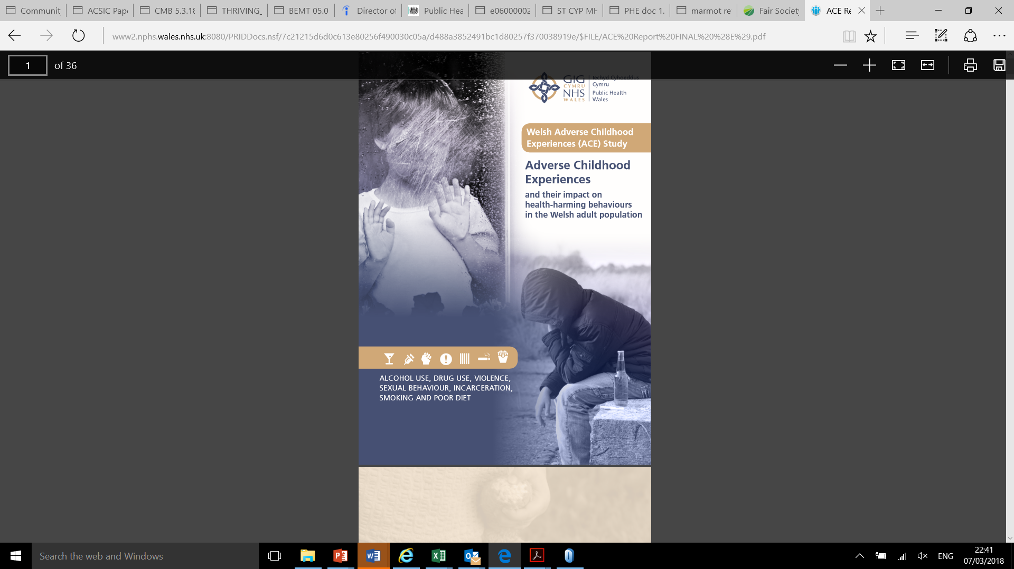

Adverse Childhood experiences and child trauma

Slide 29
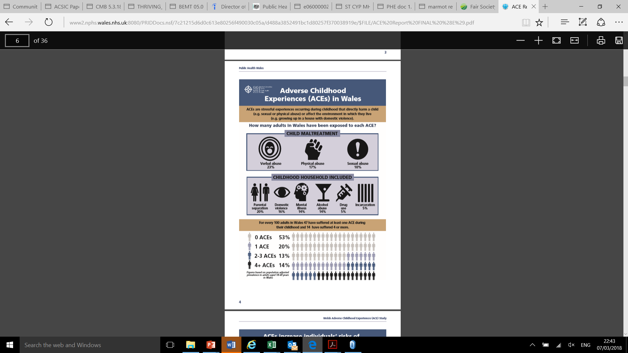
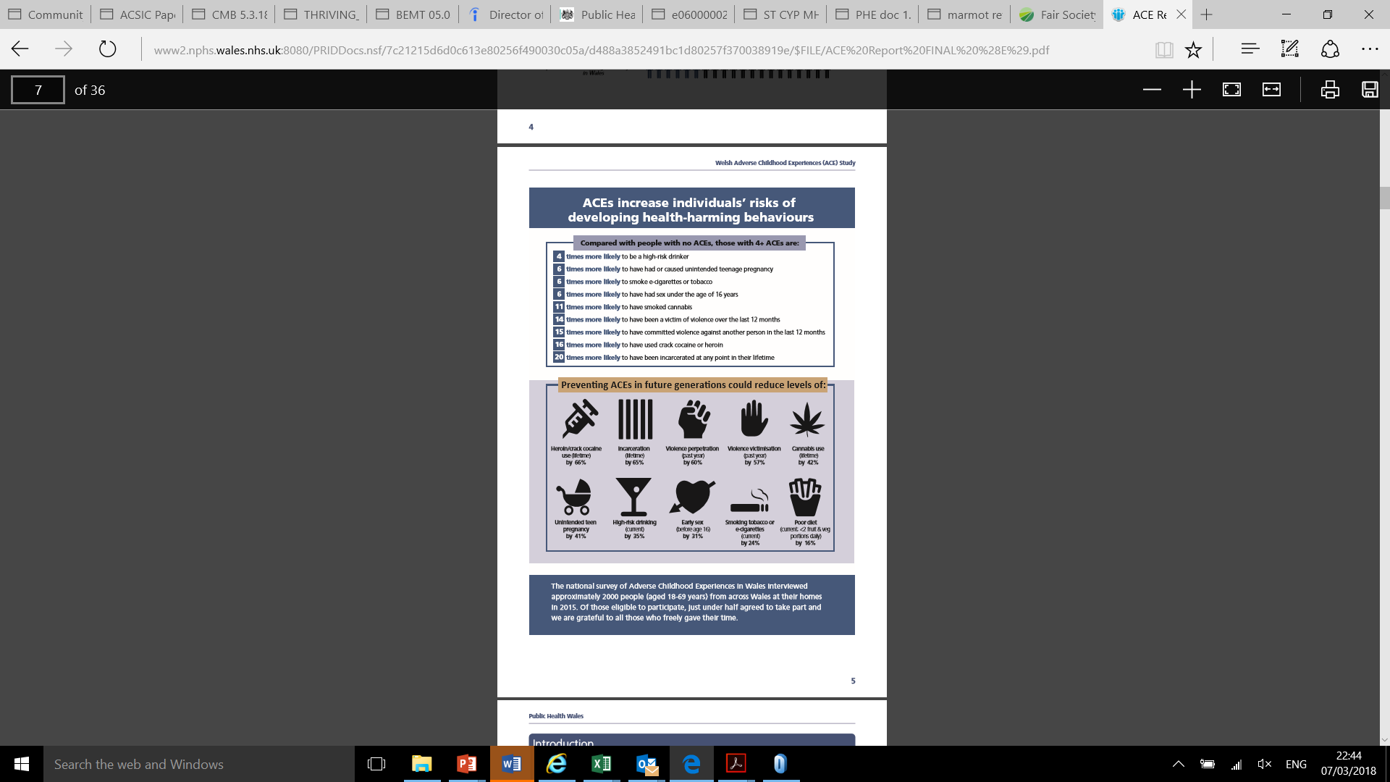

Slide 30
Thank you

